Slide 1
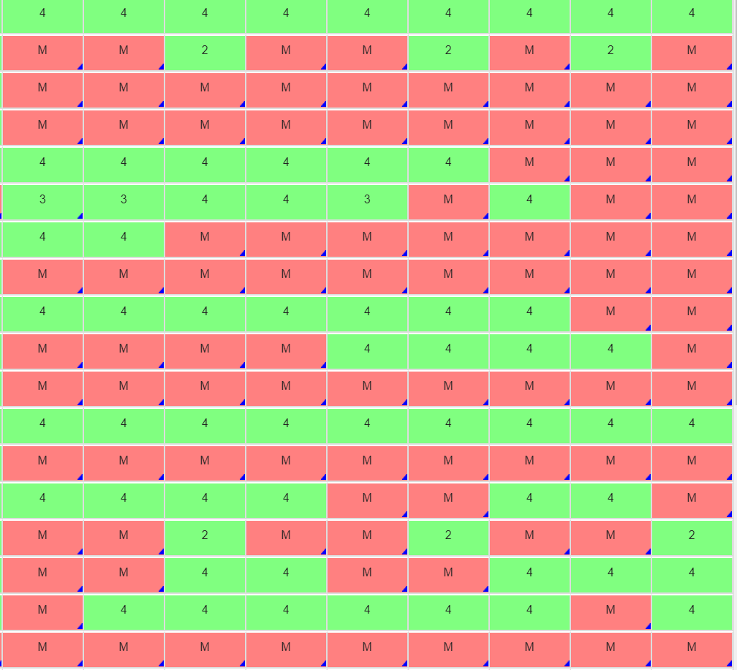
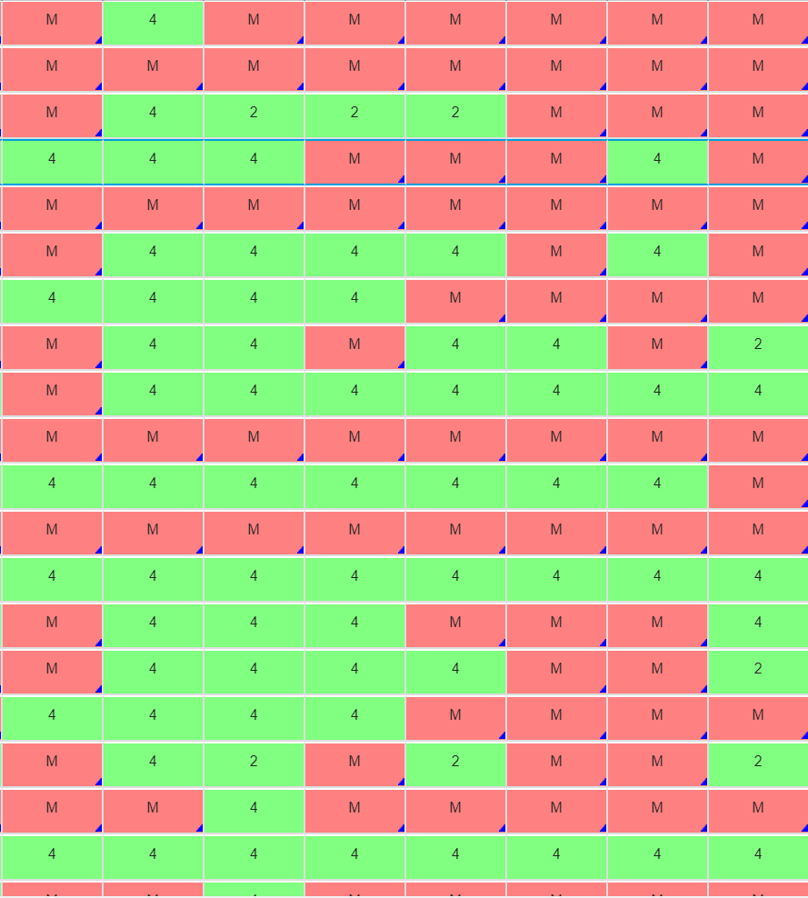
Go Over Test… Talk about Homework…

Slide 2
Pre-calc trig
Day 23

Slide 3
Bell Work: Things to Make Sure You Know Spend 5-8 minutes clarifying with partner, small group any issues you may be having with the following list.
Degree, Max, Min, Zeros, End Behavior, Domain and Range.
Write equation given zeros (real and imaginary)
Simplify with imaginary
Factor and find all zeros with graph
Sketch a graph and write equation given characteristics of a rational function
Identify vertical, horizontal asymptotes, holes, x-intercepts and y-intercepts

Slide 4

Equations “Needed” for Test
$$\sqrt{−1}=i$$
$${y−y}_{1}=m\left(x−x_{1}\right)$$
$$x=\frac{−b±\sqrt{b^{2}−4ac}}{2a}$$
$${\text{Given} \text{f}\text{(}\text{x}\text{) }\text{then} f}^{′}\left(x\right)=\lim_{h→0}{\frac{f\left(x+h\right)−f(x)}{h}}$$

Slide 5
After Test
Finish and turn in any missing homework as listed on the board by the door.
Read or sit quietly until everyone is finished.

